Slide 1
DBMS PROJECT -1 DATA BASE DESIGNING TOPIC:BLOOD DONATION
PROJECT MEMBERS:DASHRATH KUMAR(22CSB0B40)
HERAMB RALLAPALLY (22CSB0F19)
TANMAY SONI (22CSB0B25)

Slide 2
PROBLEM STATEMENT
In our society, unprecedented accidents and emergencies occur without warning, often leaving individuals in critical need of blood transfusions to sustain their lives. Unfortunately, the demand for blood often surpasses the available resources, leading to critical shortages and putting lives at risk. Addressing this challenge, our team has come up with a database design which aims to provide immediate donation of blood , and takes care of blood compatibility.

Slide 3
ENTITY SET OF OUR DATABASE
1) Blood bank (weak entity)
2) Donor
3) Recipient
4) Hospital
5) Staff
6) Blood_count

Slide 4
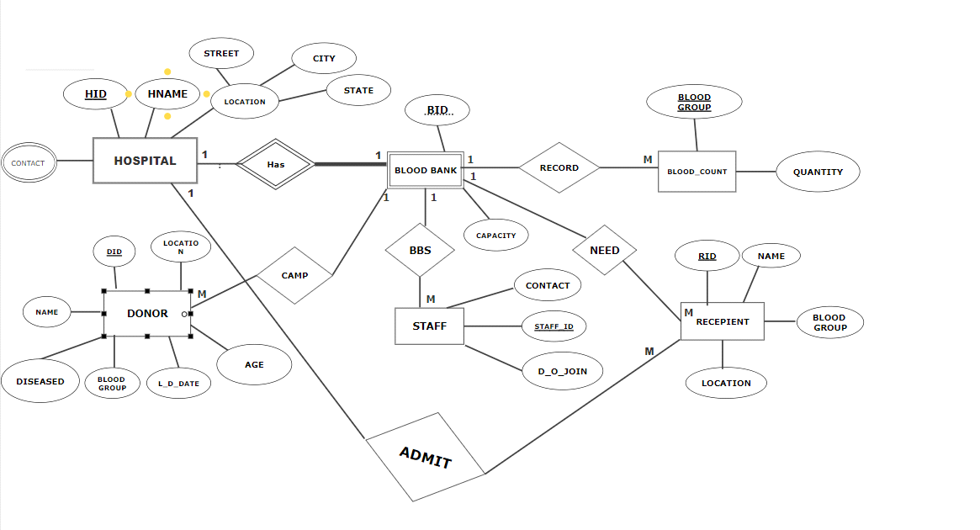
ER MODEL

Slide 5
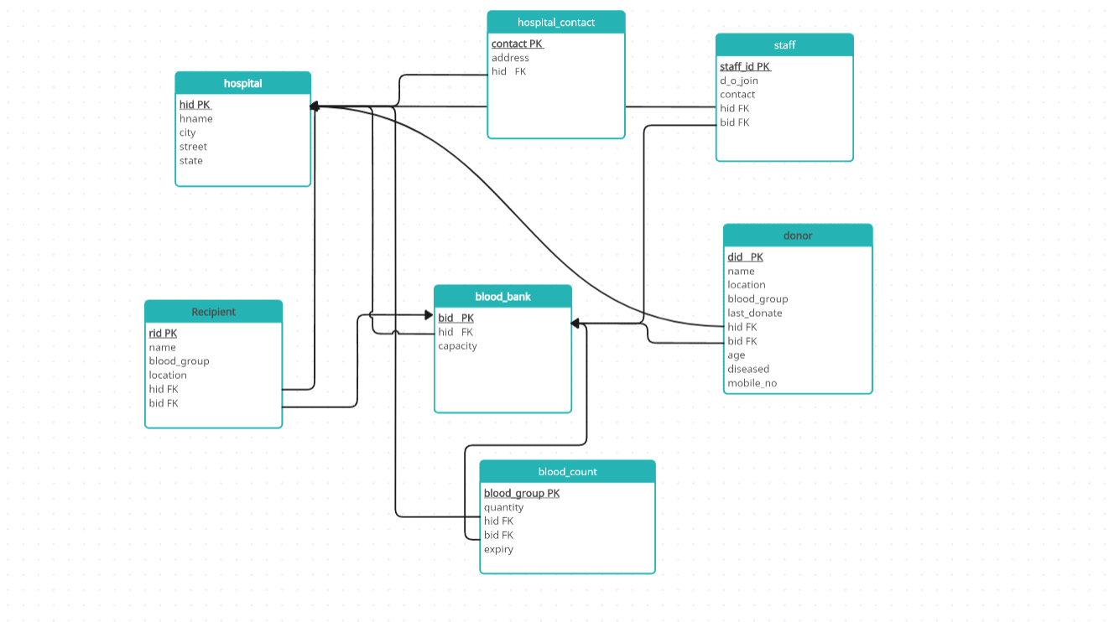
RELATIONAL DIAGRAM

Slide 6
ASSUMPTIONS MADE:
Each hospital ,will have only one blood bank.
Recipient can receive blood either from the hospital he/she is admitted in or directly from the blood bank.
Each donor will donate 1 L blood.

Slide 7
RELATIONAL TABLE CREATION
create database blood_donation;
use blood_donation;
1)create table hospital(hid int,hname varchar(30),city varchar(30),street varchar(30),state varchar(30), primary key (hid));
2)create table blood_bank(hid int,bid int,capacity int,primary key(hid,bid));
3)create table hospital_contact(contact numeric, address varchar(50), hid int, primary key(hid,contact),
foreign key (hid) references hospital(hid));

Slide 8
4)create table donor(did int,name_ varchar(30),location varchar(30), blood_group varchar(5),last_donate date, hid int,bid int, age int, check(age>=18),diseased bool ,check (diseased=FALSE or diseased=0), mobile_no numeric(10), primary key(did,hid,bid),foreign key(hid,bid) references blood_bank(hid,bid));
5)create table blood_count(blood_group varchar(5),quantity int,hid int,bid int, expiry date, primary key(hid,bid,blood_group),foreign key (hid,bid) references blood_bank(hid,bid));
6)create table staff(staff_id int,d_o_join date,contact int,hid int,bid int,
primary key(hid,bid,staff_id),foreign key(hid,bid) references blood_bank(hid,bid));

Slide 9
7)CREATE TABLE COMPAT(dbg varchar(5),rbg varchar(5),primary key (dbg,rbg));
8)create table recepient(rid int,name_ varchar(30),blood_group varchar(5),location varchar(30),
hid int,bid int, primary key(hid,bid,rid),foreign key(hid,bid) references blood_bank(hid,bid));

Slide 10
DATA INSERTION
INSERT INTO HOSPITAL VALUES(1,'HIRANANDANI','THANE','ESTATE','MAHARASHTRA');
INSERT INTO HOSPITAL VALUES(2,'JUPITER','THANE','LBS','MAHARASHTRA');
INSERT INTO HOSPITAL VALUES(3,'LOVELY','mumbai','RGL','MAHARASHTRA');
insert into hospital values(4,'GMCH','Jalore','Ring_road','Rajasthan');
insert into hospital values(5,'SMS','Jaipur','Moti_road','Rajasthan');
insert into hospital values(6,'GOVT_hospital','Jaipur','Rambagh_street','Rajasthan');
insert into hospital values(7,'AIIMS_Jodhpur','Jodhpur','Pal_road','Rajasthan');
select *from hospital;
insert into blood_bank values(1,1,100);
insert into blood_bank values(2,2,120);
insert into blood_bank values(3,3,125);
insert into blood_bank values(4,4,110);
insert into blood_bank values(5,5,115);

Slide 11
insert into hospital_contact values(4924114141,'01_ESTATE_THANE',1);
insert into hospital_contact values(4254114141,'21_LBS_THANE',2);
insert into hospital_contact values(9824114141,'12_RGL_MUMBAI',3);
insert into hospital_contact values(7384114141,'1_RINGROAD_JALORE_RJ',4);
insert into hospital_contact values(1924114141,'11_MOTIROAD_JAIPUR',5);
insert into hospital_contact values(9824114741,'112_RAMBAGH_PALACE_JAIPUR',6);
insert into hospital_contact values(9924114141,'1_PALROAD_JODHPUR',7);
INSERT INTO donor VALUES (1, 'HERAMB', 'THANE', 'AB+', '2023-03-27', 1, 1,20,FALSE,423456789);
INSERT INTO DONOR values(2,'PRANAV','THANE','B+','2022-02-24',1,1,22,FALSE,3434567890);
INSERT INTO DONOR values(3,'SIDDH','THANE','A-','2022-02-24',1,1,21,FALSE,2534567890);
INSERT INTO DONOR values(4,'SHIRISH','THANE','AB+','2020-02-24',1,1,23,FALSE,3434567890);
INSERT INTO DONOR values(5,'HARSH','THANE','O-','2018-02-24',2,2,43,FALSE,5634567890);
INSERT INTO DONOR values(6,'PARTH','THANE','O+','2017-01-30',2,2,40,FALSE,9434567890);

Slide 12
INSERT INTO DONOR values(7,'RONIT','THANE','AB-','2019-06-05',2,2,54,FALSE,1334567890);
INSERT INTO DONOR values(8,'BHUSHAN','THANE','B-','2011-06-05',2,2,45,FALSE,9234567890);
INSERT INTO donor VALUES (11, 'Abhishek', 'Jaipur', 'A+', '2023-10-15', 7, 7, 20, 0, 1234567890);
INSERT INTO donor VALUES (12, 'Priya_Sharma', 'Mumbai', 'B-', '2023-11-20', 4, 4, 30, 0, 9876543210);
INSERT INTO donor VALUES (13, 'Ramesh_Patel', 'Jodhpur', 'O+', '2023-09-05', 7, 7, 34, 0, 8765432109);
INSERT INTO donor VALUES (14, 'Sunita_Singh', 'Jalore', 'AB+', '2023-12-18', 5, 5, 24, 0, 7654321098);
INSERT INTO donor VALUES (15, 'Amit_Gupta', 'Jaipur', 'A-', '2023-08-30', 7, 7, 43, 0, 6543210987);
INSERT INTO donor VALUES (16, 'Anjali_Devi', 'Mumbai', 'B+', '2023-10-25', 7, 7, 21, 0, 5432109876);
INSERT INTO donor VALUES (17, 'Sandeep_Mishra', 'Jodhpur', 'O-', '2023-11-12', 4, 4, 55, 0, 4321098765);
INSERT INTO donor VALUES (18, 'Muskan_Tiwari', 'Mumbai', 'AB-', '2023-09-28', 4, 4, 23, 0, 3210987654);
INSERT INTO donor VALUES (19, 'Rajesh_Kumar', 'Jaipur', 'A+', '2023-11-05', 5, 5, 29, 0, 2109876543);
INSERT INTO donor VALUES (20, 'Meera_Singh', 'Jalore', 'B-', '2023-10-10', 5, 5, 41, 0, 1098765432);

Slide 13
INSERT INTO donor VALUES (21, 'Arun_Sharma', 'Mumbai', 'O+', '2023-12-22', 6, 6, 62, 0, 987654321);
INSERT INTO donor VALUES (22, 'Kavita_Reddy', 'Jodhpur', 'AB+', '2023-09-15', 6, 6, 36, 0, 9876543210);
INSERT INTO donor VALUES (23, 'Sanjay_Kumar', 'Jaipur', 'A-', '2023-11-18', 6, 6, 27, 0, 8765432109);
INSERT INTO donor VALUES (24, 'Pooja_Patel', 'Mumbai', 'B+', '2023-10-05', 5, 5, 71, 0, 7654321098);
INSERT INTO donor VALUES (25, 'Durgesh_Mishra', 'Jodhpur', 'O-', '2023-08-20', 6, 6, 18, 0, 6543210987);
INSERT INTO donor VALUES (26, 'Anita_Verma', 'Jaipur', 'AB-', '2023-12-28', 4, 4, 19, 0, 5432109876);
INSERT INTO donor VALUES (27, 'Raj_Kumar', 'Mumbai', 'A+', '2023-09-02', 5, 5, 18, 0, 4321098765);
INSERT INTO donor VALUES (28, 'Radha_Gupta', 'Jodhpur', 'B-', '2023-10-30', 7, 7, 29, 0, 3210987654);
INSERT INTO donor VALUES (29, 'Suresh_Yadav', 'Jaipur', 'O+', '2023-11-15', 5, 5, 31, 0, 2109876543);
INSERT INTO donor VALUES (30, 'Kiran_Singh', 'Mumbai', 'AB+', '2023-09-08', 6, 6, 19, 0, 1098765432);
INSERT INTO donor VALUES (31, 'Kp_Singh', 'Mumbai', 'AB+', '2023-09-08', 5, 5, 19, 0, 1098765432);

Slide 14
insert into blood_count values('AB+',0,1,1);
insert into blood_count values('AB-',0,1,1);
insert into blood_count values('B+',0,1,1);
insert into blood_count values('B-',0,1,1);
insert into blood_count values('A+',0,1,1);
insert into blood_count values('A-',0,1,1);
insert into blood_count values('O+',0,1,1);
insert into blood_count values('O-',0,1,1);
insert into blood_count values('AB+',0,2,2);
insert into blood_count values('AB-',0,2,2);
insert into blood_count values('B+',0,2,2);
insert into blood_count values('B-',0,2,2);
insert into blood_count values('A+',0,2,2);
insert into blood_count values('A-',0,2,2);
insert into blood_count values('O+',0,2,2);
insert into blood_count values('O-',0,2,2);

Slide 15
insert into blood_count values('AB+',0,4,4);
insert into blood_count values('AB-',0,4,4);
insert into blood_count values('B+',0,4,4);
insert into blood_count values('B-',0,4,4);
insert into blood_count values('A+',0,4,4);
insert into blood_count values('A-',0,4,4);
insert into blood_count values('O+',0,4,4);
insert into blood_count values('O-',0,4,4);
insert into blood_count values('AB+',0,5,5);
insert into blood_count values('AB-',0,5,5);
insert into blood_count values('B+',0,5,5);
insert into blood_count values('B-',0,5,5);
insert into blood_count values('A+',0,5,5);
insert into blood_count values('A-',0,5,5);

Slide 16
insert into blood_count values('O+',0,5,5);
insert into blood_count values('O-',0,5,5);
INSERT INTO blood_count VALUES ('A+', 42, 7, 7, '2024-01-05');
INSERT INTO blood_count VALUES ('A+', 75, 4, 4, '2024-01-07');
INSERT INTO blood_count VALUES ('A+', 18, 5, 5, '2024-02-10');
INSERT INTO blood_count VALUES ('A+', 93, 6, 6, '2024-03-15');
INSERT INTO blood_count VALUES ('A-', 65, 7, 7, '2024-01-08');
INSERT INTO blood_count VALUES ('A-', 30, 4, 4, '2024-01-09');
INSERT INTO blood_count VALUES ('A-', 88, 5, 5, '2024-02-12');
INSERT INTO blood_count VALUES ('A-', 12, 6, 6, '2024-03-18');

Slide 17
INSERT INTO blood_count VALUES ('B+', 82, 7, 7, '2024-01-11');
INSERT INTO blood_count VALUES ('B+', 47, 4, 4, '2024-01-14');
INSERT INTO blood_count VALUES ('B+', 55, 5, 5, '2024-02-16');
INSERT INTO blood_count VALUES ('B+', 39, 6, 6, '2024-03-20');
INSERT INTO blood_count VALUES ('B-', 23, 7, 7, '2024-01-13');
INSERT INTO blood_count VALUES ('B-', 81, 4, 4, '2024-01-17');
INSERT INTO blood_count VALUES ('B-', 44, 5, 5, '2024-02-19');
INSERT INTO blood_count VALUES ('B-', 69, 6, 6, '2024-03-22');
INSERT INTO blood_count VALUES ('AB+', 90, 7, 7, '2024-01-21');
INSERT INTO blood_count VALUES ('AB+', 15, 4, 4, '2024-01-23');
INSERT INTO blood_count VALUES ('AB+', 37, 5, 5, '2024-02-25');
INSERT INTO blood_count VALUES ('AB+', 58, 6, 6, '2024-03-27');

Slide 18
INSERT INTO blood_count VALUES ('AB-', 50, 7, 7, '2024-03-29');
INSERT INTO blood_count VALUES ('AB-', 64, 4, 4, '2024-01-29');
INSERT INTO blood_count VALUES ('AB-', 78, 5, 5, '2024-02-20');
INSERT INTO blood_count VALUES ('AB-', 26, 6, 6, '2024-03-01');
INSERT INTO blood_count VALUES ('O+', 77, 3, 3, '2024-01-02');
INSERT INTO blood_count VALUES ('O+', 9, 4, 4, '2024-01-03');
INSERT INTO blood_count VALUES ('O+', 71, 5, 5, '2024-02-04');
INSERT INTO blood_count VALUES ('O+', 33, 6, 6, '2024-03-29');
INSERT INTO blood_count VALUES ('O-', 22, 7, 7, '2024-01-06');
INSERT INTO blood_count VALUES ('O-', 85, 4, 4, '2024-01-07');
INSERT INTO blood_count VALUES ('O-', 56, 5, 5, '2024-02-08');
INSERT INTO blood_count VALUES ('O-', 41, 6, 6, '2024-03-09');

Slide 19
INSERT INTO STAFF VALUES(101,'2020-07-18',12345,1,1);
INSERT INTO STAFF VALUES(102,'2021-05-10',54321,1,1);
INSERT INTO STAFF VALUES(103,'2022-02-18',21435,1,1);
INSERT INTO STAFF VALUES(104,'2013-07-18',12346,1,1);
INSERT INTO STAFF VALUES(105,'2022-01-07',12543,1,1);
INSERT INTO STAFF VALUES(201,'2021-07-18',98765,2,2);
INSERT INTO STAFF VALUES(202,'2021-05-10',56789,2,2);
INSERT INTO STAFF VALUES(203,'2012-02-18',56879,2,2);
INSERT INTO STAFF VALUES(204,'2014-07-18',57969,2,2);
INSERT INTO STAFF VALUES(205,'2015-01-07',76985,2,2);

Slide 20
INSERT INTO staff VALUES (10, '2022-05-15', 9123456780, 7, 7);
INSERT INTO staff VALUES (11, '2022-06-20', 9876543210, 7, 7);
INSERT INTO staff VALUES (12, '2022-07-25', 8765432109, 4, 4);
INSERT INTO staff VALUES (13, '2022-08-30', 9345678901, 4, 4);
INSERT INTO staff VALUES (14, '2022-09-10', 8456789012, 5, 5);
INSERT INTO staff VALUES (15, '2022-10-15', 9567890123, 5, 5);
INSERT INTO staff VALUES (16, '2022-11-20', 5678901234, 6, 6);
INSERT INTO staff VALUES (17, '2022-12-25', 6789012345, 6, 6);
INSERT INTO staff VALUES (18, '2023-01-30', 7890123456, 7, 7);
INSERT INTO staff VALUES (19, '2023-02-05', 8901234567, 7, 7);

Slide 21
insert into COMPAT values('O-','AB+');
insert into COMPAT values('O-','AB-');
insert into COMPAT values('O-','B+');
insert into COMPAT values('O-','B-');
insert into COMPAT values('O-','A+');
insert into COMPAT values('O-','A-');
insert into COMPAT values('O-','O+');
insert into COMPAT values('O-','O-');
insert into COMPAT values('O+','AB+');
insert into COMPAT values('O+','B+');

Slide 22
insert into COMPAT values('O+','A+');
insert into COMPAT values('O+','O+');
insert into COMPAT values('A-','AB+');
insert into COMPAT values('A-','AB-');
insert into COMPAT values('A-','A+');
insert into COMPAT values('A-','A-');
insert into COMPAT values('A+','AB+');
insert into COMPAT values('A+','A+');
insert into COMPAT values('B-','AB+');
insert into COMPAT values('B-','AB-');
insert into COMPAT values('B-','B+');
insert into COMPAT values('B-','B-');

Slide 23
insert into COMPAT values('B+','AB+');
insert into COMPAT values('B+','B+');
insert into COMPAT values('AB-','AB+');
insert into COMPAT values('AB-','AB-');
insert into COMPAT values('AB+','AB+');

Slide 24
INSERT INTO recepient VALUES (1, 'Rahul', 'A+', 'Jaipur', 7, 7);
INSERT INTO recepient VALUES (2, 'Priya', 'B-', 'Jodhpur', 7, 7);
INSERT INTO recepient VALUES (3, 'Raja_Singh', 'O+', 'Jaipur', 4, 4);
INSERT INTO recepient VALUES (4, 'Sunita', 'AB+', 'Jodhpur', 5, 5);
INSERT INTO recepient VALUES (5, 'Ayush_Gupta', 'A-', 'Jaipur', 6, 6);
INSERT INTO recepient VALUES (7, 'Sudeep', 'O-', 'Jalore', 4, 4);
INSERT INTO recepient VALUES (8, 'Sneha', 'AB-', 'Jaipur', 5, 5);
INSERT INTO recepient VALUES (9, 'Rahul', 'A+', 'Jaipur', 6, 6);
INSERT INTO recepient VALUES (10, 'Mika_Singh', 'B-', 'Jalore', 7, 7);
INSERT INTO recepient VALUES (11, 'Aditi', 'O+', 'Jodhpur', 4, 4);
INSERT INTO recepient VALUES (12, 'Venkat_Reddy', 'AB+', 'Jaipur', 5, 5);
INSERT INTO recepient VALUES (13, 'Sanjay_Goyal', 'A-', 'Jodhpur', 6, 6);
INSERT INTO recepient VALUES (14, 'Akshar_Patel', 'B+', 'Jaipur', 7, 7);
INSERT INTO recepient VALUES (15, 'Rohit_Sharma', 'O-', 'Jalore', 4, 4);

Slide 25
OUR MODEL SAMPLE QUERIES
1)UPDATION OF BLOOD COUNT IN A PARTICULAR BLOOD BANK OF A BLOOD GROUP
update blood_count
set quantity=quantity+1
WHERE (blood_group ='A+' and hid=1 and bid=1);
2)FOR FINDING DONOR FROM A NEAREST OR SPECIFIC LOCATION OF A BLOOD GROUP
select *from donor where location='mumbai' and blood_group='B+’;
3) IF A PATIENT IS ADMITTED IN HOSPITAL AND HE/SHE NEEDS BLOOD THEN WE CAN SEARCH COMPATIBLE BLOOD IN A BLOOD BANK
select * from blood_count where (hid,bid)=(select hid,bid from recepient where rid=1) and blood_group IN (select rbg from compat where dbg='A+’);

Slide 26
4)IF A PATIENT IS ADMITTED IN HOSPITAL,TO RECEIVE COMPATIABLE AND MAXIMUM AVAILABLE BLOOD GROUP OF A PERSON
select blood_group,hid,bid from blood_count where quantity=(select max(quantity) as maxavail from blood_count where (blood_group) in ((select dbg from compat where (rbg) in (select blood_group from recepient where name_='RAHUL'))));
5)TO UPDATE THE BLOOD COUNT OF A BLOOD BANK OF THE GROUP DONATED TO THAT PERSON
set @bd=(select blood_group from (select blood_group,hid,bid from blood_count where quantity=(select max(quantity) as maxavail from blood_count where (blood_group) in ((select dbg from compat where (rbg) in (select blood_group from recepient where name_='RAHUL')))))as kl);
set @hd=(select blood_group from (select blood_group,hid,bid from blood_count where quantity=(select max(quantity) as maxavail from blood_count where (blood_group) in ((select dbg from compat where (rbg) in (select blood_group from recepient where name_='RAHUL')))))as kl);
update blood_countset quantity=quantity-1where blood_group=@bd and hid=@hd and bid=@hd;
6) finding the blood which gonna expire today or on a specific date related to a hospital
SELECT * FROM blood_count WHERE expiry = DATE_FORMAT(NOW(), '%Y-%m-%d') and hid=7;

Slide 27
7)IF HOSPITAL /BANK WILL ALLOW TO DONATE ONLY WHEN DONOR HAS LAST DONATED ATLEAST 4 MONTHS BEFORE
select *from donor where location='THANE' and blood_group='AB+' and (extract(month from last_donate)+4<=extract(month from sysdate())or extract(year from last_donate)+1<=extract(year from sysdate())) and diseased=0;
8) IF blood bank has deficiency of blood of a blood group then it can contact other blood bank
select contact,hid from hospital_contact where (hid) in (select hid from blood_count where blood_group='AB+' and quantity>0 ) and hid!=1;
9) LISTING BLOOD GROUP ALONG WITH ITS TOTAL QUANITITY
select blood_group,sum(quantity) as amount_ltr from blood_count group by blood_group;

Slide 28
NORMALIZATION
In every relation , which we have defined all the functional dependencies ,hold in a such a way that the primary key always determines all the other attributes.
Super key->(All attributes),this is the typical situation of a relation to be in BCNF.
Hence , all our relations are in BCNF. We have made sure to minimize the anomalies as far as possible!

